Slide 1

Managing projects by data
Version: 1.1
Author: Le The Hung
Oct 23, 2001
Instructor: Le The Hung
Head of SEPG
© 2001 FPT-SOFT
04e-BM/NS/HDCV/FSOFT

Slide 2
Introduction
Course duration: 1 hour 45’
Purpose: Practical use of data for managing projects
Targeted attendees: Team leaders, SEPG, SQA
Tests/quiz: Quiz in 15’ for new attendants

Slide 3
Objectives
After the course, student will be able to:
Understand Fsoft metric system.
Know about PCBs and norms.
Use data for managing projects.

Slide 4
Table of contents
Fsoft metric system – 30’ for new attendants, 5’ for getting update
Fsoft PCB and Norms – 45’
Project database template – 30’ for new attendants, 10’ for getting update
Quiz – 15’ for new attendants

Slide 5
Fsoft metric system
Fsoft quality objectives
Fsoft metric set
Analysis tools

Slide 6

Fsoft quality objective
  “FPTSoft pledges to deliver software/service which fully meet customer’s requirements on schedule defined in project plan”

Slide 7
Requirements
ISO 9001:2001
  8.2.3 Monitoring and measurement of the processes
  8.4 Analysis of data
CMM/SEI 1.1:
  PA.G1: The quantitative process management activities are planned
  PA.G2: The process performance of the project's defined software process is controlled quantitatively
  PA.G3: The process capability of the organization's standard software process is known in quantitative terms

Slide 8

Metric set: Collected data
Effort (Project, work product, process, type of activity): Weekly
Schedule (Start-date, expected end-date, actual end-date, delivery): At milestones
Defect (Project, work product, stage detected, QC activities, stage injected, process origin, severity, classification type, priority): Weekly
Size (Total, work product, activity): At milestones
Requirement (Total, size, status): Weekly
Customer complaints, customer satisfaction survey point, NC

Slide 9
Metric set: Calculated indicators
Effort (Effectiveness, deviation): Weekly
Schedule (Timeliness, deviation): At milestones
Defect (Defect rate, leakage): Weekly
Size (Deviation): At milestones
Requirement (Completeness): Weekly
Productivity, customer satisfaction, process compliance, distribution (Effort, defects): At the end of project

Slide 10
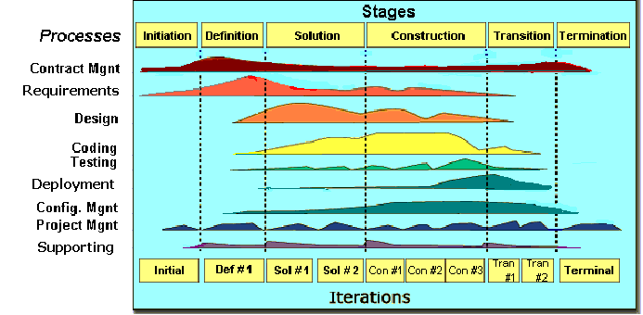
Fsoft SLC models: Manage by data

Slide 11
Initiation stage: Norms for WO
Overview
  The Initiation stage is the start of the SLC, in which:
  Project's software scope and boundary conditions, including the operational vision and proposed products, are established.
  Overall cost and schedule of the project are estimated.
  Potential risks are defined.
Metrics
  Estimated effort and planned schedule for the project.
  Target value of the quality goals for the project: Timeliness, Completeness, Leakage, Correct Cost, Customer Satisfaction, Process Compliance.
  Actual data of the stage: Actual effort and actual schedule for the stage.
Help
  Use Fosft norms for setting goals.
  Record in the Project database

Slide 12
Definition stage: PCB for Planning
Overview
  Studying and clarifying user requirements.
  Preparing and releasing SRS.
  Negotiating Acceptance Criteria with customer.
  Updating and releasing complete project plan.
Metrics
  Estimated size for the project, estimated effort and planned schedule for the stage.
  Progress values of the quality goals: Timeliness, Completeness, Leakage, Correct Cost, Process Compliance.
  Actual data of the stage: Actual effort and actual schedule for the stage, actual size and defects of the project plan, URD and SRS.
Help
  Use Fosft norms for estimating and planning.
  Fill data in the Project database
  Analysis by viewing the Charts and log issue in the Issue sheet

Slide 13
Solution stage: Review metrics
Overview
  The main purpose of this stage is to define an effective solution to meet customer requirements.
  Analyzing and creating a good design for the software package are the main activities.
Metrics
  Estimated effort and planned schedule for the stage.
  Progress values of the quality goals : Timeliness, Completeness, Leakage, Correct Cost, Process Compliance.
  Actual data of the stage: Actual effort and actual schedule for the stage, actual size and defects of the ADD and Test Plan.
Help
  Use Fosft norms for estimating and planning.
  Fill data in the Project database
  Analysis by viewing the Charts and log issue in the Issue sheet

Slide 14
Construction stage: Data analysis
Overview
  The goal of the construction stage is to develop the system.
  Coding and testing for the software package are the main activities.
Metrics
  Estimated effort and planned schedule for the stage.
  Progress values of the quality goals : Timeliness, Completeness, Leakage, Correct Cost, Process Compliance.
  Actual data of the stage: Actual effort and actual schedule for the stage, actual size and defects of the DDD, Test case and Test Data, modules and unit programs.
Help
  Use Fosft norms for estimating and planning.
  Fill data in the Project database
  Analysis by viewing the Charts and log issue in the Issue sheet

Slide 15
Transition stage: Leakage
Overview
  The focus of the Transition stage is to ensure that software is available for its end users. Delivering software to customer, implementing software systems on customer site and conducting test activities for acceptance are main activities of this stage.
Metrics
  Estimated effort and planned schedule for the stage.
  Progress values of the quality goals: Timeliness, Completeness, Leakage, Correct Cost, Process Compliance.
  Actual data of the stage: Actual effort and actual schedule for the stage, actual size and defects of the software package.
Help
  Use Fosft norms for estimating and planning.
  Fill data in the Project database
  Analysis by viewing the Charts and log issue in the Issue sheet

Slide 16
Termination stage: Fsoft Data
Overview
  The project closes at this stage when customer accepts the whole project and signs off the contract. Project assets must be collected and transferred to FPTSoft process asset library.
  The goal of this stage is to summarize the results of the project and to provide the project knowledge and experiences for other projects.
Metrics
  Estimated effort and planned schedule for the stage.
  Final values of the quality goals: Timeliness, Completeness, Leakage, Correct Cost, Customer Satisfaction, Process Compliance.
  Actual data of the stage: Actual effort and actual schedule for the stage, customer satisfaction point.
Help
  Use Fosft norms for estimating and planning.
  Fill data in the Project database
  Analysis by view the Charts

Slide 17
Analysis tools – Cause-Effect
Purpose
  It help to accurately identify causes (or results) of a problem.
How to use
  Brainstorming.
Test
Code
Design
Analysis
Defect rate is high
SQA
Technology
Team
Time

Slide 18
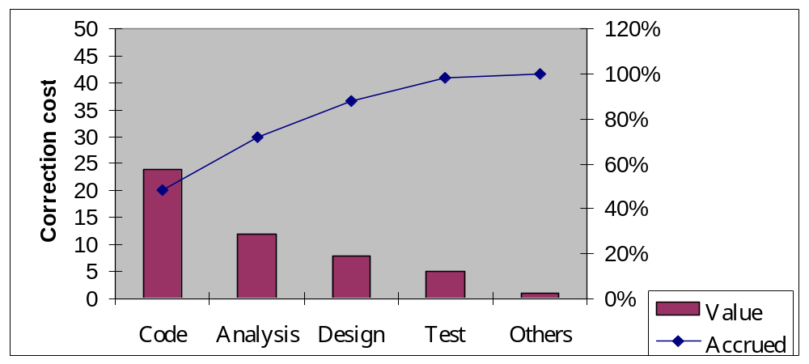
Analysis tools – Pareto Chart
Purpose
  It helps identify most important issues by data.
How to use
  The rule 80:20.

Slide 19
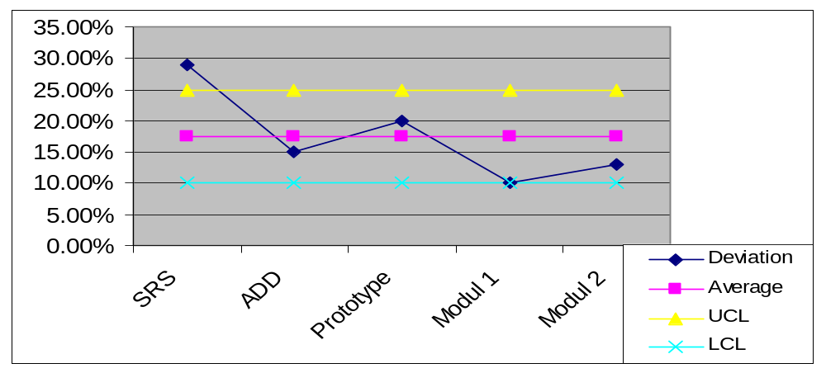
Analysis tools – Control Chart
Purpose
  It helps to define and forecast uncontrolled cases.
How to use
  Average, Stdev, UCL, LCL of serie of data

Slide 20
Fsoft PCB and Norms
Fsoft PCB:
  1.0: June 30, 2001
  2.0: Sep 30, 2001
  3.0: Jan 31, 2002
  4.0: Mar 31, 2002
Fsoft norms for Q4-2001

Slide 21
PCB 2.0: Data collection
12 Projects have postmortem in May-Sep of 2001
Planned Actions
  To make data accurate
  To use data effectively
All mandatory software metrics are calculated

Slide 22
PCB 2.0: Data collection
Issues:
  Requirement Breakdown
  Planned Efforts for Activities
  Completeness of Milestones
  Classification of Defect and Severity
  Size in UCP
Actions for Q4
  Collect all necessary data
  SQA has responsibility for defect data
  SEPG check data weekly

Slide 23

Fsoft PCB 2.0: Schedule
It’s the most serious problem now
Timeliness (%) 84.9|95|58.6
Schedule Deviation (%)
  New development: 23.5|10|62.5
  Enhancement: 5|10|30.6

Slide 24

Fsoft PCB 2.0: Effort
Effort Deviation (%)
  New development: 29.8|10|40.48
  Enhancement: 4.9|10|32.97
Project management effort (%)
  New development: 4.5|7.5|6.06
  Enhancement: 3.8|7.5|5.69
Quality Cost (%)
  New development: 39|30|34.48
  Enhancement: 34.8|30|51.75
Correction Cost (%)
  New development: 16.3|12|9.92
  Enhancement: 18.4|12|12.27

Slide 25

Fsoft PCB 2.0: Quality
Defect Rate:
  (Def/KLOC) 8.3|8|15.72
  (WDef/KLOC) N/A|N/A|53.88
Leakage
  (Def/KLOC) N/A|1|0.58
  (WDef/KLOC) N/A|N/A|1.60
Defect Removal Efficiency (%)
  Review N/A|30|32.9
  Test N/A|65|62.0
Customer Satisfaction (Point) N/A|85|73.5

Slide 26
Fsoft PCB 2.0: Requirement
Accepted deliverable (%) N/A|95|94.4
Requirement completeness (%) N/A|95|93.83

Slide 27
Fsoft PCB 2.0: Productivity
Productivity (LOC/md) 43.8|40|43.9
Review Effectiveness (Def/md) N/A|N/A|3.03
Test Effectiveness (Def/md) N/A|N/A|2.30

Slide 28

Fsoft norms for Q4-2001
Oct 01- Dec 31, 2001
Timeliness is our problem now!!!
To make data accurate
  Collection: All of project teams
  Verification: SEPG
To use data effectively
  Using PCB for plan: All processes
  Re-estimate size: After SRS completion and at the end of the project
  Analysis in progress: All milestones
  Verification: SEPG

Slide 29

Fsoft norms for Q4-2001
Requirement
  Accepted deliverable: 95%
  Requirement completeness: 95%
Schedule
  Timeliness: 75%
  Schedule Deviation: 10%
Effort
  Effort Deviation: 10%
  Management Effort: 7.5%
  Quality Cost: 30%
  Correction Cost: 12%

Slide 30
Fsoft norms for Q4-2001
Product Quality
  Defect Rate: 50 weighted def/KLOC
  Leakage: 1.5 weighted def/KLOC
  Customer Satisfaction: 85 points
Productivity
  Coding: 40 LOC/md
  Review: 2.5 Defects/md
  Test: 2.5 Defects/md

Slide 31
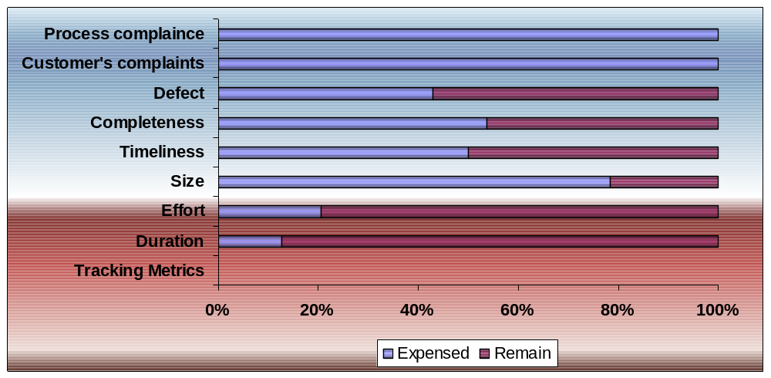
Project database template
To record project metrics
To manage project by data
To help for creating a project report

Slide 32

3 rules
Customer is our God
Most of the World could be changed
Managing Quality is always profitable

Slide 33

Conclusion
Pls. give your assessment

Slide 34
Sources & references
Sources
  Fsoft manual
  Fsoft standard life cycle models and tailoring guidelines
  Fsoft metric guidelines and project database template
  Assessment and analysis tools guidelines
  Fsoft PCB reports
  Fsoft norms
Recommended readings
  Ttvn/sys/project/cmm-4/document/master list

Slide 35
Questions and Answers

Slide 36
Quiz
Total 100 points = 20 questions x 5 points/question
Duration: 15’
Pass criteria: 75 points
Feel free to use any available material
Don’t brainstorm.

